Slide 1
Accessors & Mutators

Slide 2
Why use classes at all?
Classes and objects are more like the real world. They minimize the semantic gap by modeling the real world more closely
The semantic gap is the difference between the real world and the representation in a computer
Do you care how your TV works?
– No… you are a user of the TV, the TV has operations and they work. You don’t care how

Slide 3
Why use classes at all?
Classes and objects allow you to define an interface to some object (it’s operations) and then use them without know the internals
Defining classes helps modularize your program into multiple objects that work together, that each have a defined purpose

Slide 4
Encapsulation
Attributes and behaviors are enclosed (encapsulated) within the logical boundary of the object entity
– In structured or procedural systems, data and code are typically maintained as separate entities (e.g., modules and data files)
– In Object Technology systems, each object contains the data (attributes) and the code (behaviors) that operates upon those attributes

Slide 5
Abstraction
Encapsulation implements the concept of abstraction: – details associated with object sub- components are enclosed within the logical boundary of the object
– user of object only “sees” the public interface of the object, all the internal details are hidden

Slide 6
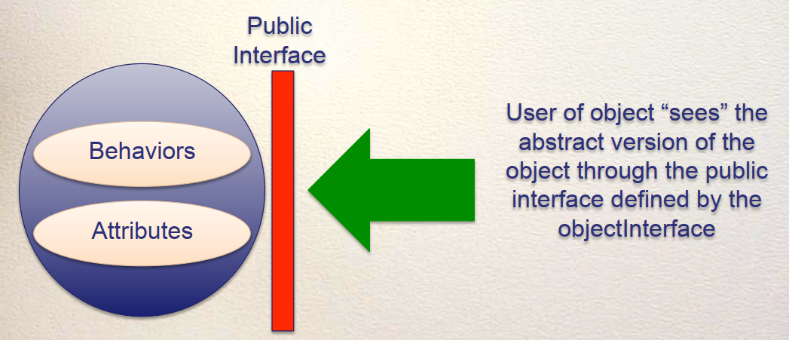
Abstraction
Encapsulation makes abstraction possible

Slide 7
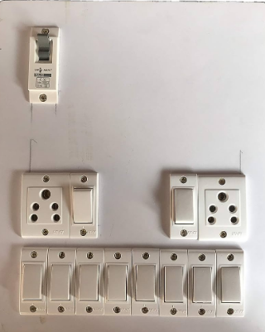

Abstraction in your life

Slide 8
Abstraction in your life
You know the public interface. Do you know implementation details? Do you care?
As long as the public interface stays the same, you don’t care about implementation changes

Slide 9
Think?
Should class attributes be accessed in driver program and can be set?
like
ali=Person(“ali”)
ali.age=27

Slide 10
Implementing Public/Private Interfaces
In Java/ c++ you will be able to enforce access restrictions on your instance variables… you can (and should) make them private so Java itself enforces data encapsulation.
So… does Python support “private” instance variables? Yes (and no)

Slide 11
Implementing Public/Private Interfaces
Can we ENFORCE use of getters and setters?
If I design a class I would like to make sure no one can access my instance variables directly, they MUST use my getters and setters.

Slide 12
Implementing Public/Private Interfaces
Python attributes and methods are public by default.
– public attributes: any other class or function can see and change the attribute
myCircle.radius = 20
– public method: any other class or function can call the method myCircle.method1()

Slide 13
Implementing Public/Private Interfaces
Private attributes can (almost) only be accessed by methods defined in the class
Private methods can (almost) only be called by other methods defined in the class
Idea: Everything defined in the class has access to private parts.

Slide 14
Hiding your private parts (in Python)
You can create somewhat private parts in Python. Naming an instance variable with an __ (two underscores) makes it private

Slide 15
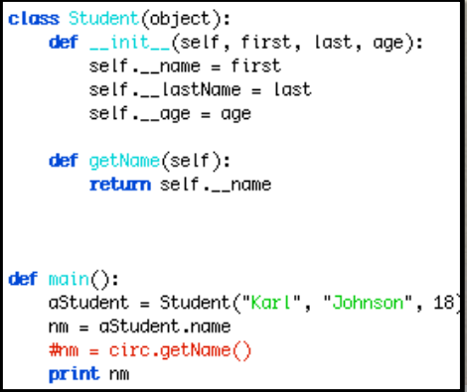
Hiding your private parts (in Python)
Gives Error

Slide 16
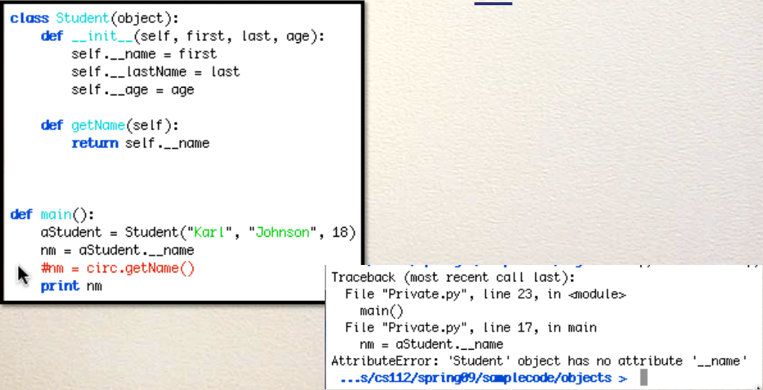
Hiding your private parts (in Python)
Be a little sneakier then.. use __name:

Slide 17
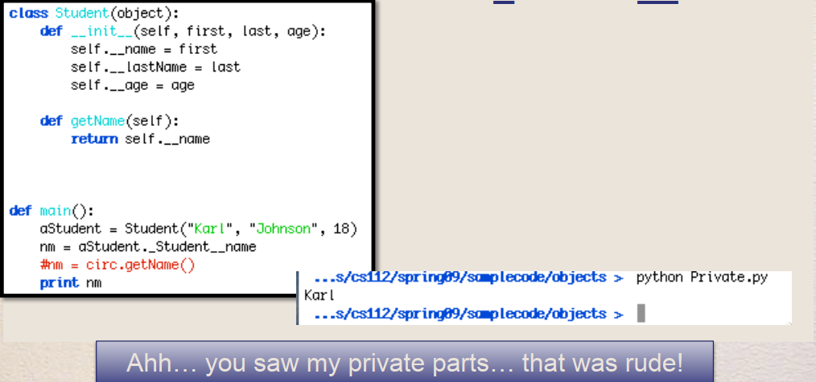
Hiding your private parts (in Python)
Be super sneaky then.. use _Student__name:

Slide 18
Hiding your private parts (in Python)
So, it is possible to interact with private data in Python, but it is difficult and good programers know not to do it. Using the defined interface methods (getters and setters) will make code more maintainable and safer to use

Slide 19
Getters & Setters (or) Accessors & Mutators
These methods are a coding convetion
Getters/Accessors are methods that return an attribute
def get_name(self):
Setters/Mutators are methods that set an attribute def set_name(self,newName):

Slide 20
Why use getters?
Definition of my getter:
def getName(self):
return self.name
What if I want to store the name instead as first and last name in the class? Well, with the getter I only have to do this:
def getName(self):
return self.firstname + self.lastname

Slide 21
Why use getters?
If I had used dot notation outside the class, then all the code OUTSIDE the class would need to be changed because the internal structure INSIDE the class changed.
Getters help you hide the internal structure of your class!

Slide 22
Why use getters?
Think about libraries of code… If the Python-authors change how the Button class works, do you want to have to change YOUR code? No! Encapsulation helps make that happen. They can change anything inside they want, and as long as they don’t change the method signatures, your code will work fine.

Slide 23
Setters
Anoter common method type are “setters”
def setAge(self, age):
self.age = age
Why? Same reason + one more. I want to hide the internal structure of my Class, so I want people to go through my methods to get and set instance variables. What if I wanted to start storing people’s ages in dog-years? Easy with setters:
def setAge(self, age):
self.age = age / 7

Slide 24
Setters
More commonly, what if I want to add validation… for example, no age can be over 200 or below 0? If people use dot notation, I cannot do it. With setters: def setAge(self, age):
if age > 200 or age < 0:
# show error
else:
self.age = age / 7

Slide 25
Getters and Setters
Getters and setters are useful to provide data encapsulation. They hide the internal structure of your class and they should be used!

Slide 26
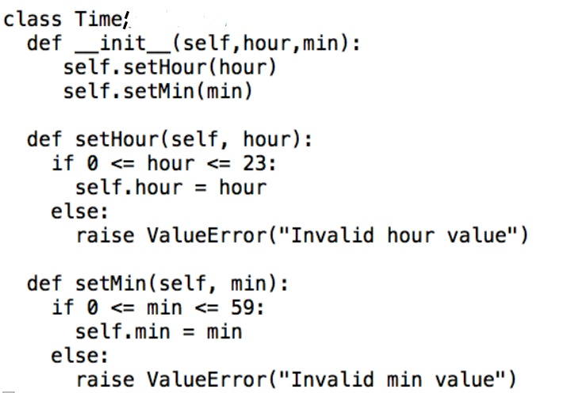
Example

Slide 27
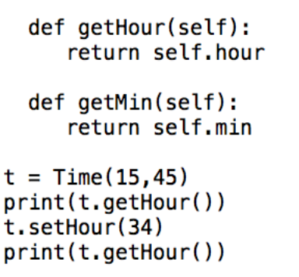
Example

Slide 28
Task
Modify the Room with proper accessors & mutators and update the class constructor as well.

